Slide 1
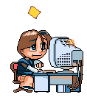
What are they doing?

Slide 2
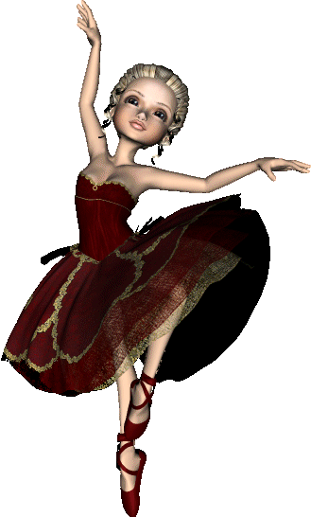
The girl/dance
The girl is dancing.

Slide 3
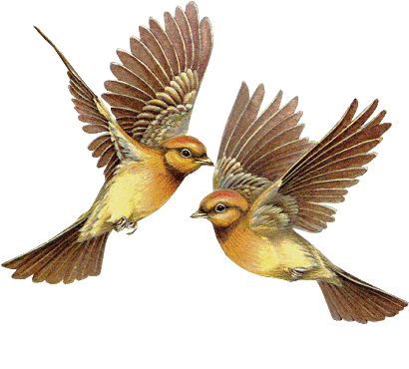
The birds are flying.
The birds/fly

Slide 4
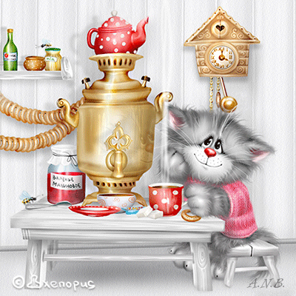
The cat/drink tea
The cat is drinking tea.

Slide 5
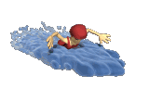
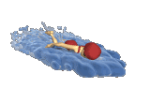
The girls are swimming.
The girls/swim

Slide 6
It is snowing.
It/snow

Slide 7
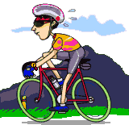
The sportsman/ride a bike
The sportsman is riding a bike.

Slide 8
They /play loud music
They are playing loud music.

Slide 9
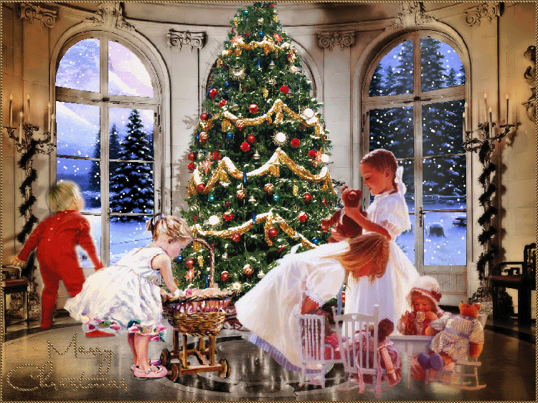
The children are playing.
The children/play

Slide 10
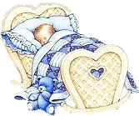
The baby/sleep
The baby is sleeping.

Slide 11
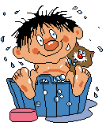
The boy is washing.
The boy/wash

Slide 12
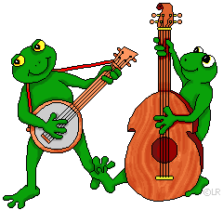
The frogs are playing musical instruments.
The frogs/play musical instruments

Slide 13
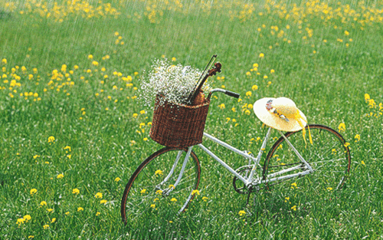
It/rain
It is raining.

Slide 14
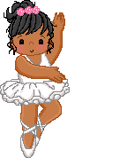
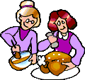
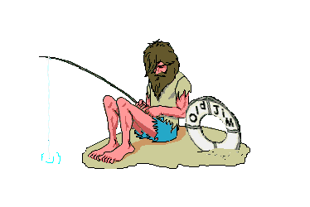
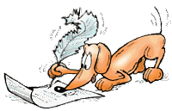
Guess what the people are doing.
Is he…?
Is she…? Are they…?
Is it…?

